Slide 1
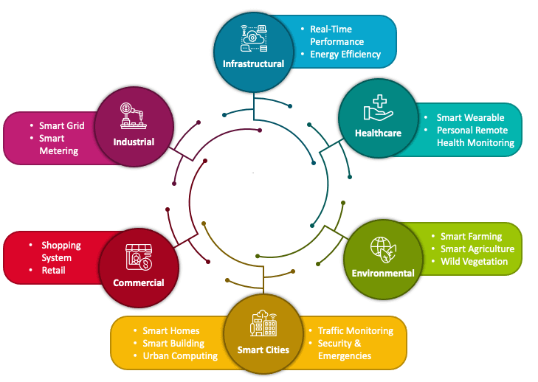

IoT
IoT Network Architecture and Design
Pandapotan Siagian
https://github.com/siagianp
https://www.youtube.com/@AmelOline/videos
https://github.com/amelcharolinesgn2/IoT_simulator-mqtt-NodeRed
https://github.com/amelcharolinesgn2/Cloud-Infrastructures
https://github.com/amelcharolinesgn2/ClouD-Infrastructure-SISKA-2025
https://github.com/amelcharolinesgn2/IoT_app-and-Modules
Notes:
https://www.coursehero.com/file/59100338/IoT-Network-Architecture-and-Designpptx/
https://mindmajix.com/iot-architecture
https://www.slideshare.net/slideshow/iot-network-architecture-and-designpptx/263250698
https://www.geeksforgeeks.org/architecture-of-internet-of-things-iot/

Slide 2
Keywords
Security and Privacy in Internet of Things :
IoT network security
IoT cloud integration
IoT low power design
Big data and IoT
Videos:
https://youtu.be/Bbho6YGovsY
Notes:
https://www.sciencedirect.com/science/article/pii/S095965262032922X

Slide 3
Table Of Content
Unraveling IoT’s Problem-Solving Potential
Drivers Behind new Network Architecture
Comparing IoT Architecture
Simplified IoT Architecture
Core IoT Functional Stack
IoT Data Management and Compute Stack

Slide 4
Table Of Content
Investigate
Solved
Drivers Behind new Network Architecture
Comparing IoT Architecture
Simplified IoT Architecture
Core IoT Functional Stack
IoT Data Management and Compute Stack
Notes:
IoT Solutions for Complex Problems

Slide 5
Unraveling IoT’s Problem-Solving Potential
Determine the Problem
Choosing the Correct Hardware and Software
Data Privacy and Security
Integration
Data analysis and application
Constant Improvement >>IoT solutions and service >>IoT Application
IoT Solutions for Complex Problemsx

Slide 6
Drivers Behind New Network Architecture
OT (Operational Technology) networks, which is the target area of IoT Implementation, have unique characteristics and constraints that are not easily supported by traditional IT network architectures.
In General, they key different between traditional IT and IoT is the data
Traditional IT concerned with a reliable and continuous support of business application (email, web, ERP)
IoT is all about the data generated by sensors, how it is used, transported, collected, analyzed and acted upon
5 main drivers:
Scale
Security
Constrained device and networks
Data
Legacy Device Support

Slide 7
Scale
Millions of endpoints in IoT network need different approach in implementation and operation compared to thousands of nodes in traditional IT networks
E.g. IPv4 address space exhaustion is unable to meet IoT scalability requirement.
Solution is to use IPv6

Slide 8
Security
Case: at 3:30 p.m. on December 23, 2015, the Ukrainian power grid (SCADA System) experienced an unprecedented cyber attack that affected approximately 225,000 customers.
IoT devices which often physically exposed introduce a new challenge in designing security strategy.
Requirements for optimum IoT system security:
Authentication (Be able to identify and authenticate all entities involved in the IoT service)
Encryption (Ensure that all user data shared between the endpoint device and back-end applications is encrypted)
Secure data storage (Comply with local data protection legislation so that all data is protected and stored correctly)
Utilize an IoT connectivity management platform and establish rules- based security policies.
Take a holistic, network-level approach to security (Firewall, WAF, IDS/IPS)

Slide 9
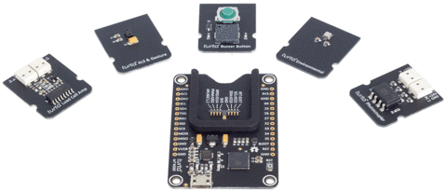
Constrained Devices and Networks
Most IoT sensors are designed for a single job, and they are typically small and inexpensive
Limited power,
Limited CPU
Limited Memory
Limited data transfer capability.
IoT requires a new breed of connectivity technologies that meet both the scale and constraint limitations
ESP32 SoC (system on chip):
80 to 240MHz CPU,
4MB Flash,
520KB RAM,
low power sleep,
ADC, SPI, I2C, UART

Slide 10
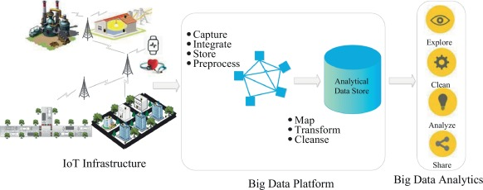
Data
Data is generated by millions of nodes
How to transport data from thousands – millions of nodes to data center?
Unstructured format, how to to store and analyze the data?

Slide 11
Legacy Device Support
Different from traditional IT Network devices, IoT end devices are likely to be on the network for a very long time (decades)
In the era of bluetooth, wireless sensors, IoT infrastructure often have to support device based on Serial connectivity (RS-232)

Slide 12
Comparing IoT Architecture
Two best known IoT Standard architecture
oneM2M IoT Standardized Architecture
IoT World Forum (IoTWF) Standardized Architecture

Slide 13
oneM2M IoT Standardized Architecture
In an effort to standardize the rapidly growing field of machine-to-machine (M2M) communications, the European Telecommunications Standards Institute (ETSI) created the M2M Technical Committee in 2008.
Goal: create a common architecture that would help accelerate the adoption of M2M applications and devices and expanded to include IoT.

Slide 14
Main Elements of oneM2M IoT Architecture
Application Entities (AEs) reside within individual device and sensor applications.
Provides a standardized interface to manage and interact with applications.
Common Services Entities (CSEs) resides between the applications layer and the in the network layer.
The network layer ensures that devices and sensors and applications are able to function in a network-agnostic manner

Slide 15
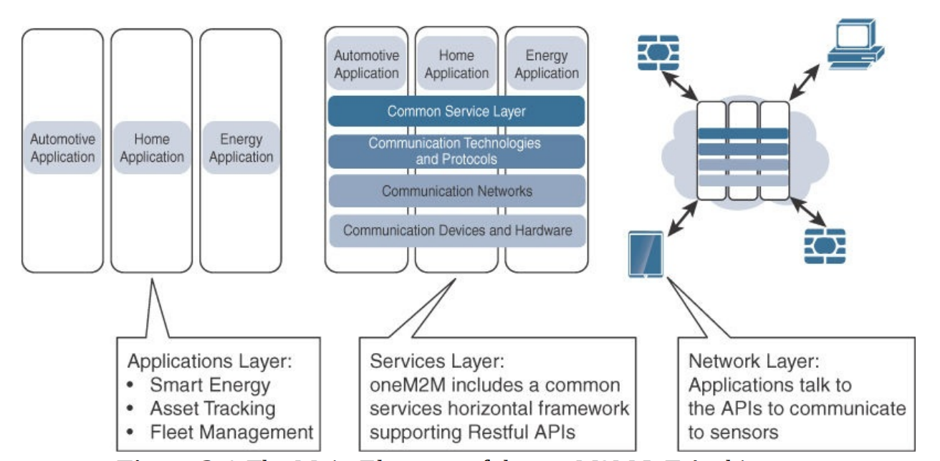
Main Elements of oneM2M IoT Architecture (Top down)

Slide 16
IoTWF Standardized Architecture
In 2014 the IoTWF architectural committee (led by Cisco, IBM, Rockwell Automation, and others) published a seven-layer IoT architectural reference model
Physical Device and Controllers
Connectivity
Edge Computing
Data Accumulation
Data Abstraction
Application
Collaboration and Processes

Slide 17
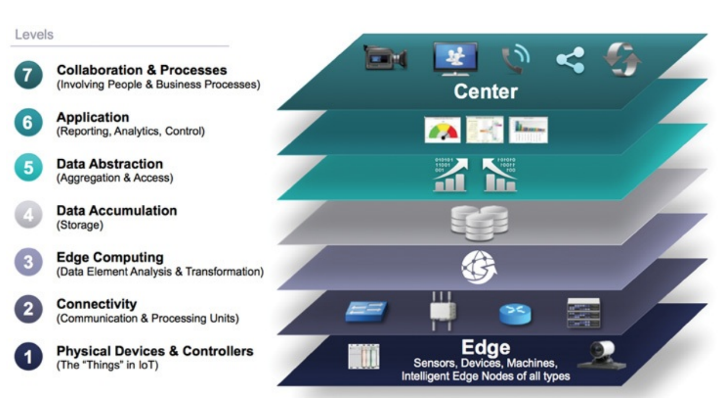
IoTWF Architecture layers

Slide 18
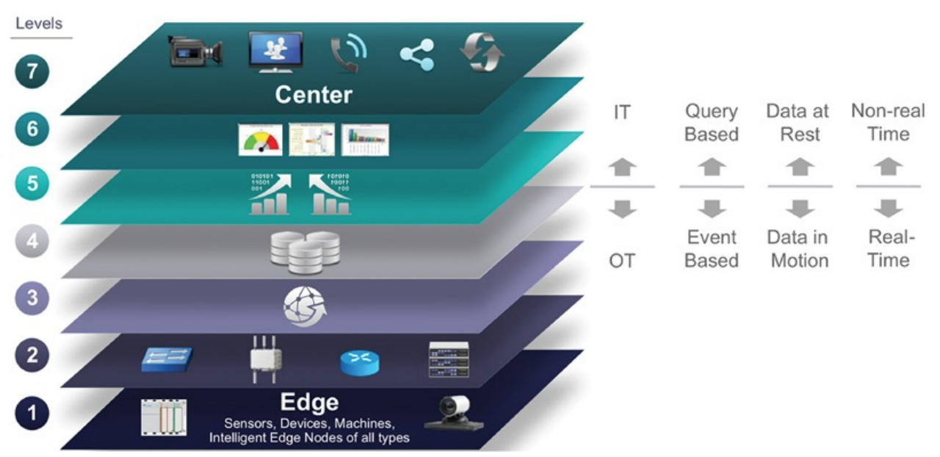
IT and OT (IoT) responsibilities in the IoTWF Architecture

Slide 19
Additional IoT Architecture
Purdue Model for Control Hierarchy
Industrial Internet Reference Architectgure (IIRA) by Industrial Internet Consortium (IIC)
Internet of Things-Architecture (IoT-A)

Slide 20
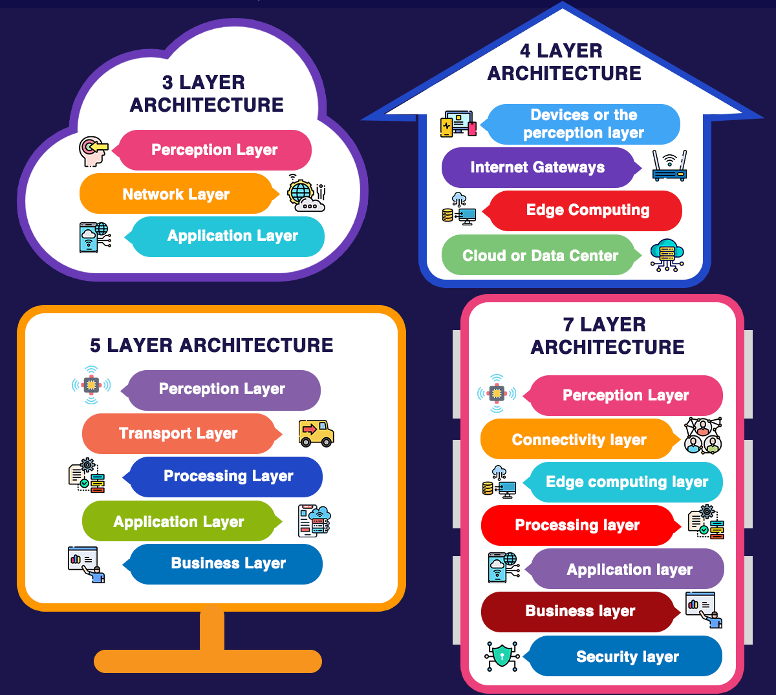
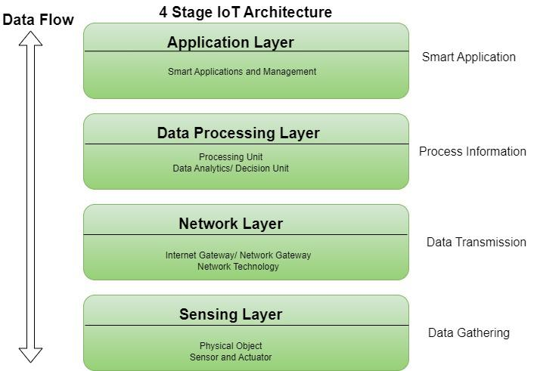
Simplified IoT Architecture Layers
Layers of IoT Architecture
3 layer architecture
4 layer architecture
5 layer architecture
7 layer architecture
To be Continued..
Notes:
https://www.geeksforgeeks.org/architecture-of-internet-of-things-iot/
Healthcare
Earthquake detection
Radiation detection/hazardous gas detection
Smartphone detection
Water flow monitoring
Traffic monitoring
Smart door lock protection system
Robots and Drones
Healthcare and Hospitals, Telemedicine applications
Biochip Transponders (For animals in farms)
Heart monitoring implants (Example Pacemaker, ECG real time tracking)

Slide 21
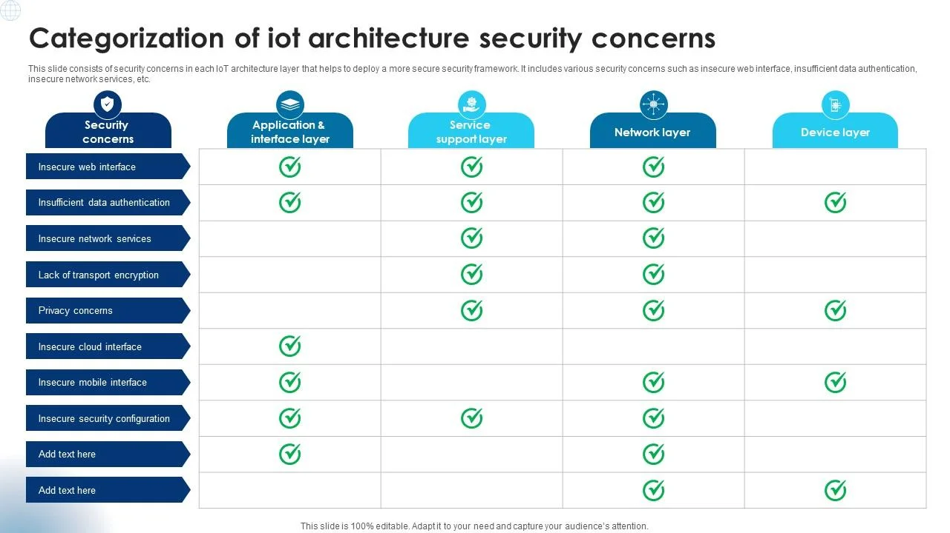
IoT network security

Slide 22
References
htps://en.wikipedia.org/wiki/Internet_of_things

Slide 23
Mauliate Godang

Slide 24
Architecture of IoT
The architecture of IoT is divided into 4 different layers i.e. Sensing Layer, Network Layer, Data processing Layer, and Application Layer.
Sensing Layer: The sensing layer is the first layer of the Internet of Things architecture and is responsible for collecting data from different sources. This layer includes sensors and actuators that are placed in the environment to gather information about temperature, humidity, light, sound, and other physical parameters. Wired or wireless communication protocols connect these devices to the network layer.
Network Layer: The network layer of an IoT architecture is responsible for providing communication and connectivity between devices in the IoT system. It includes protocols and technologies that enable devices to connect and communicate with each other and with the wider internet. Examples of network technologies that are commonly used in IoT include WiFi, Bluetooth, Zigbee, and cellular networks such as 4G and 5G technology. Additionally, the network layer may include gateways and routers that act as intermediaries between devices and the wider internet, and may also include security features such as encryption and authentication to protect against unauthorized access.
Data processing Layer: The data processing layer of IoT architecture refers to the software and hardware components that are responsible for collecting, analyzing, and interpreting data from IoT devices. This layer is responsible for receiving raw data from the devices, processing it, and making it available for further analysis or action.The data processing layer includes a variety of technologies and tools, such as data management systems, analytics platforms, and machine learning algorithms. These tools are used to extract meaningful insights from the data and make decisions based on that data. Example of a technology used in the data processing layer is a data lake, which is a centralized repository for storing raw data from IoT devices.
Application Layer: The application layer of IoT architecture is the topmost layer that interacts directly with the end-user. It is responsible for providing user-friendly interfaces and functionalities that enable users to access and control IoT devices.This layer includes various software and applications such as mobile apps, web portals, and other user interfaces that are designed to interact with the underlying IoT infrastructure. It also includes middleware services that allow different IoT devices and systems to communicate and share data seamlessly.The application layer also includes analytics and processing capabilities that allow data to be analyzed and transformed into meaningful insights. This can include machine learning algorithms, data visualization tools, and other advanced analytics capabilities.
Architecture-of-IoT

